Slide 1
Fundamentals of AC Circuits
Module 2: Fundamentals of AC Circuits

Slide 2
Introduction to AC Circuits
Electrical appliances in the house use alternating current (AC) circuits.

Slide 3
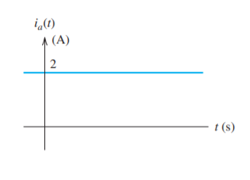
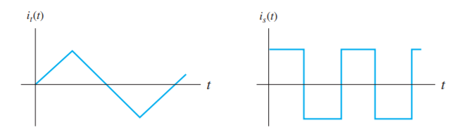
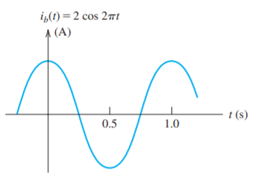
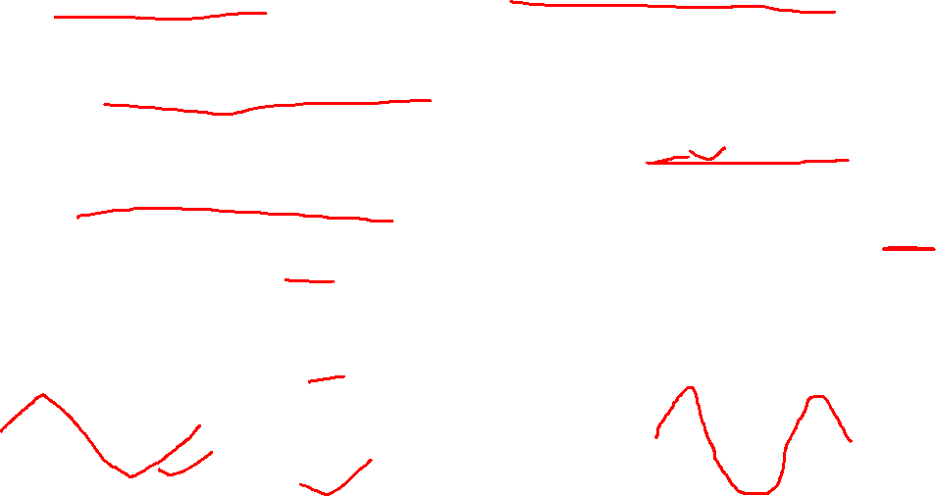
Direct Current (DC) and Alternating Current (AC)
When a current is constant with time, we say that we have direct current, abbreviated as dc
When current that varies with time, reversing direction periodically, is called alternating current, abbreviated as ac.
?

Slide 4
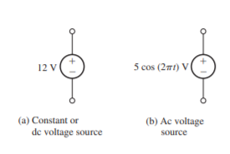

Direct Voltage (DC) and Alternating Voltage (AC)
The voltage associated with a circuit element is the energy transferred per unit of charge that flows through the element.
The units of voltage are volts (V), which are equivalent to joules per coulomb (J/C).
Voltage constant with time is called dc voltage.
Voltage that change in magnitude and alternate in polarity with time is called ac voltage.

Slide 5
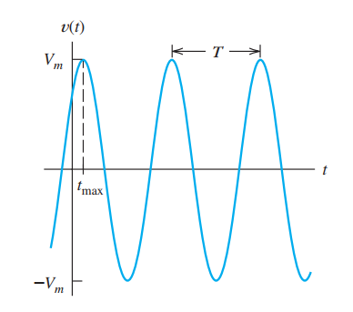
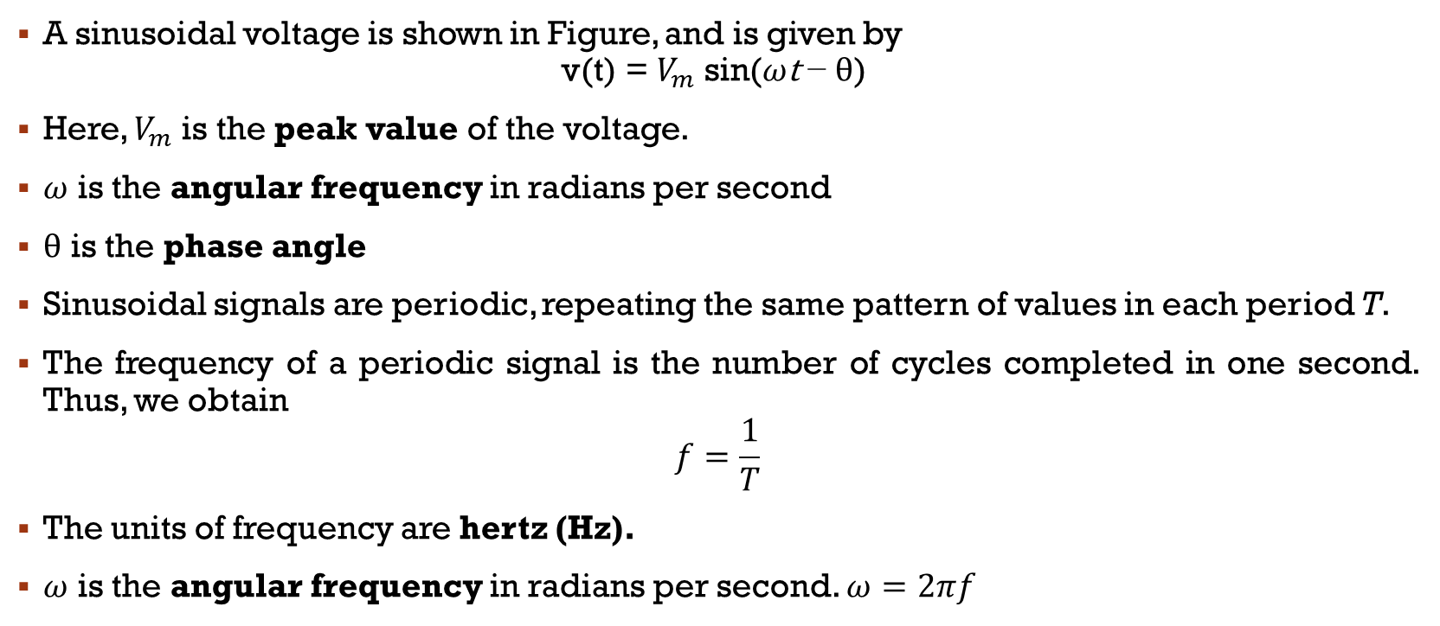
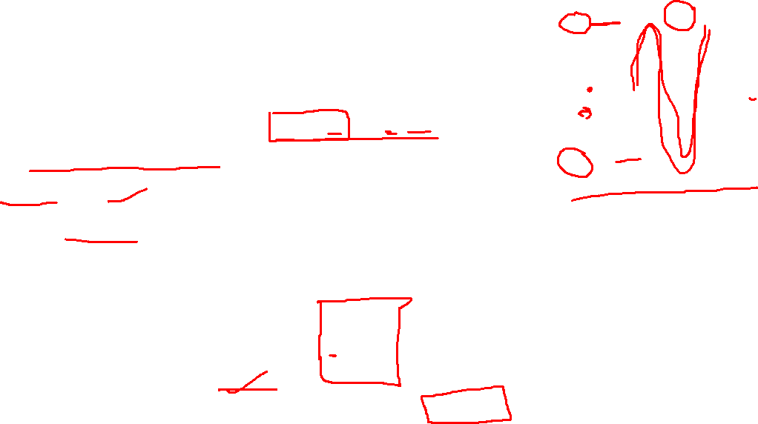
Sinusoidal AC Voltage
A sinusoidal voltage is shown in Figure, and is given by
$$\text{v}\text{(}\text{t}\text{)}\text{ = }V_{m} \text{sin}\text{(}ω\text{t} \text{−} θ\text{) }$$
Here, $V_{m}$ is the peak value of the voltage.
$ω$ is the angular frequency in radians per second
$θ$ is the phase angle
Sinusoidal signals are periodic, repeating the same pattern of values in each period T.
The frequency of a periodic signal is the number of cycles completed in one second. Thus, we obtain
$$f=\frac{1}{T}$$
The units of frequency are hertz (Hz).
$ω$ is the angular frequency in radians per second. $ω=2πf$

Slide 6
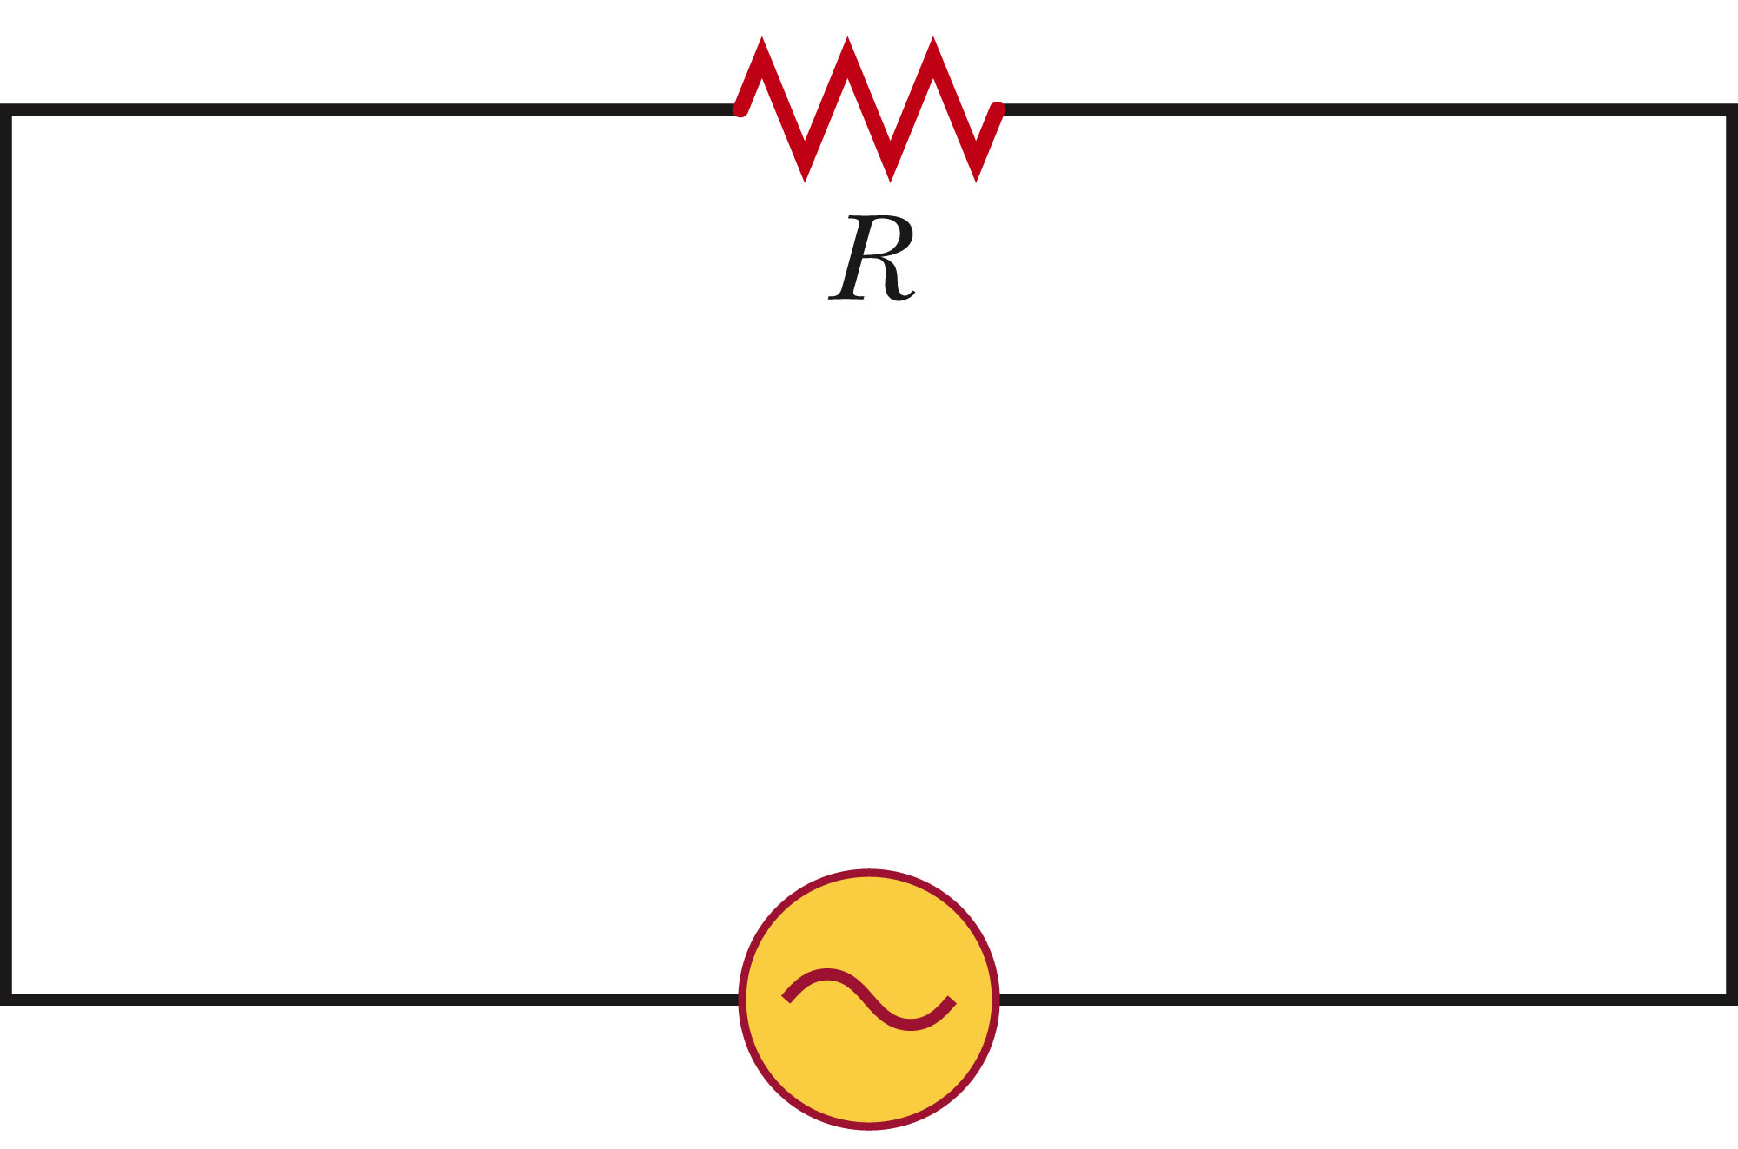
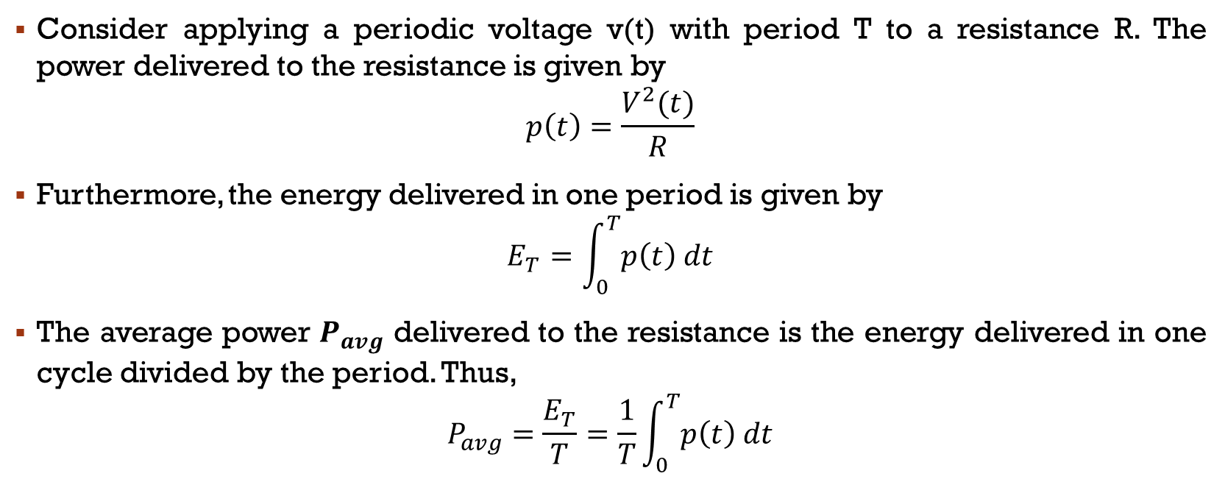
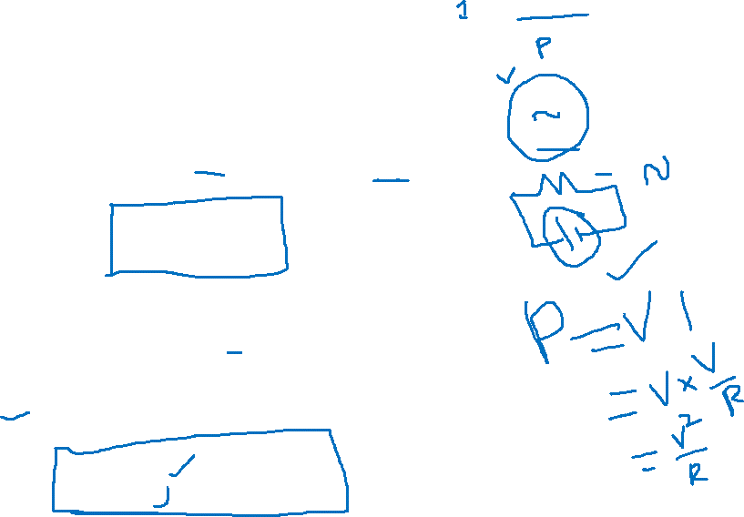
Root-Mean-Square Values
Consider applying a periodic voltage v(t) with period T to a resistance R. The power delivered to the resistance is given by
$$p\left(t\right)=\frac{V^{2}(t)}{R}$$
Furthermore, the energy delivered in one period is given by
$$E_{T}=\int_{0}^{T}{p\left(t\right) dt}$$
The average power $P_{avg}$ delivered to the resistance is the energy delivered in one cycle divided by the period. Thus,
$$P_{avg}=\frac{E_{T}}{T}=\frac{1}{T}\int_{0}^{T}{p\left(t\right) dt}$$

Slide 7
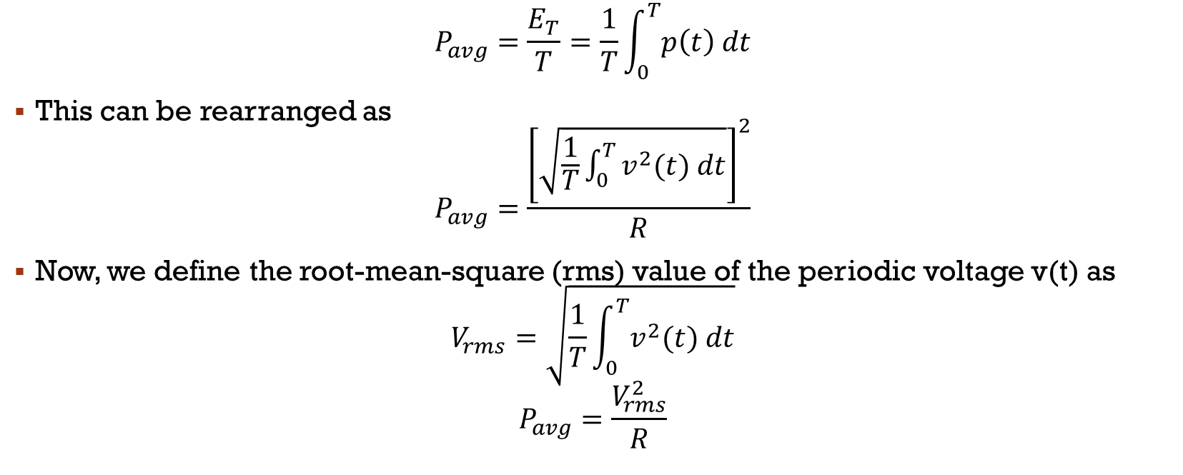
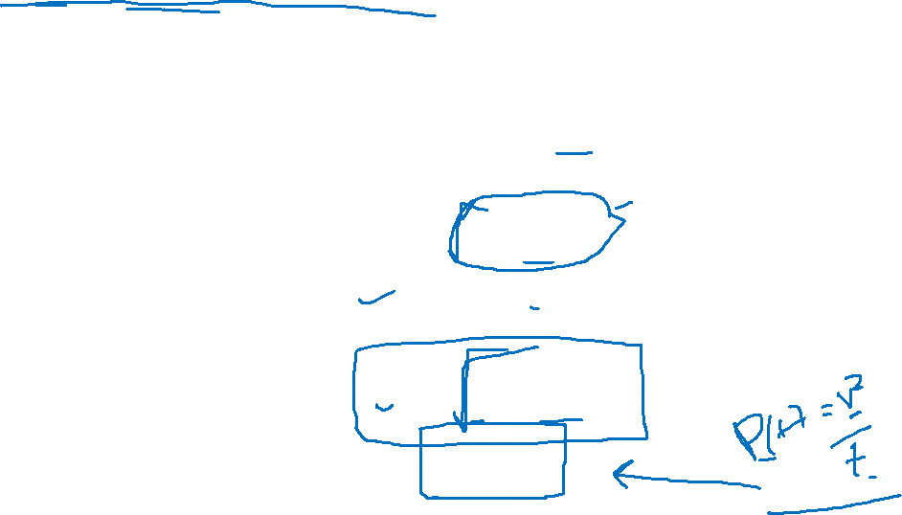
Root-Mean-Square (RMS) Values of Voltage
$$P_{avg}=\frac{E_{T}}{T}=\frac{1}{T}\int_{0}^{T}{p\left(t\right) dt}$$
This can be rearranged as
$$P_{avg}=\frac{{\left[\sqrt{\frac{1}{T}\int_{0}^{T}{v^{2}(t) dt}}\right]}^{2}}{R}$$
Now, we define the root-mean-square (rms) value of the periodic voltage v(t) as
$$V_{rms}=\sqrt{\frac{1}{T}\int_{0}^{T}{v^{2}(t) dt}}$$
$$P_{avg}=\frac{V_{rms}^{2}}{R}$$

Slide 8
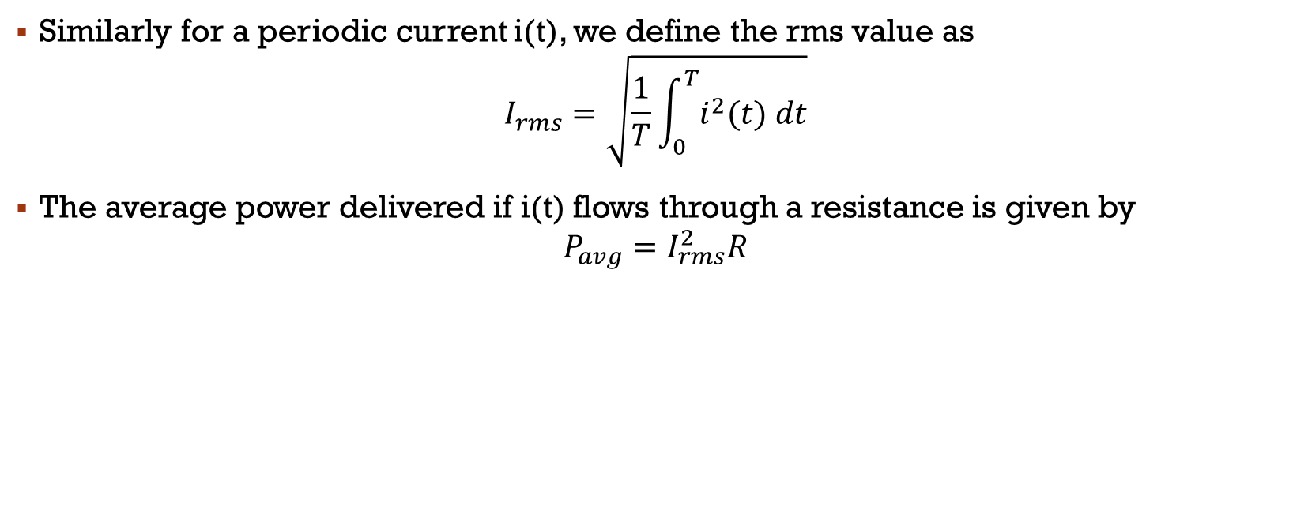
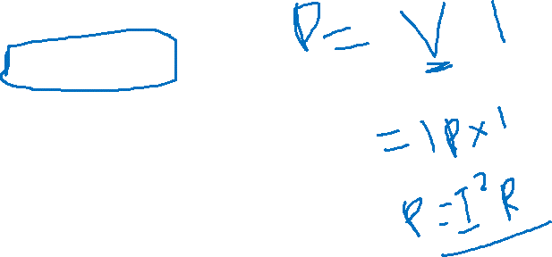
RMS Value of Current
Similarly for a periodic current i(t), we define the rms value as
$$I_{rms}=\sqrt{\frac{1}{T}\int_{0}^{T}{i^{2}(t) dt}}$$
The average power delivered if i(t) flows through a resistance is given by
$$P_{avg}=I_{rms}^{2}R$$

Slide 9


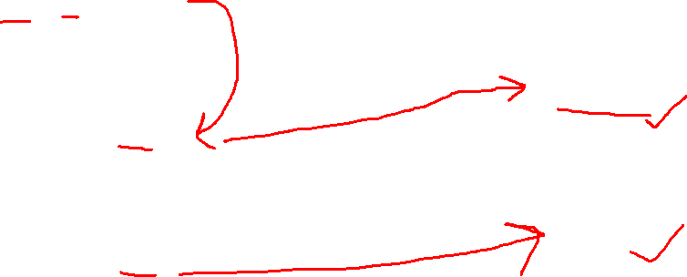
overview
$$\text{v}\text{(}\text{t}\text{)}\text{ = }V_{m} \text{sin}\text{(}ω\text{t} \text{−} θ\text{)}$$
$$f=\frac{1}{T}$$
$$ω=2πf$$
$$V_{rms}=\sqrt{\frac{1}{T}\int_{0}^{T}{v^{2}(t) dt}}$$
$$P_{avg}=\frac{V_{rms}^{2}}{R}$$
$$I_{rms}=\sqrt{\frac{1}{T}\int_{0}^{T}{i^{2}(t) dt}}$$
$$P_{avg}=I_{rms}^{2}R$$
After Substituting v(t) in $V_{rms}$
$$V_{rms}=\frac{V_{m}}{\sqrt{2}}$$
Similarly, $I_{rms}$
$$I_{rms}=\frac{I_{m}}{\sqrt{2}}$$

Slide 10
Ex 1: Power Delivered to a Resistance by a Sinusoidal Source
Suppose that a voltage given by v(t)=100cos(100wt)V is applied to a 50Ω resistance.
Sketch v(t) to scale versus time.
Find the rms value of the voltage and the average power delivered to the resistance.
Find the power as a function of time and sketch to scale

Slide 11
Ex 2 : Power Delivered to a Resistance by a Sinusoidal Source
Suppose that a sinusoidal voltage is given by
v(t) = 150 cos(200πt - 30°) V
Find the angular frequency, the frequency in hertz, the period, the peak value, and the rms value.
If this voltage is applied to a 50Ω resistance, compute the average power delivered.
Sketch v(t) to scale versus time

